Slide 1
Tutorial 6 Hashing, Collisions
Original Slides By:
Jason Christopher (@jasonc21)
jason.christopher@u.nus.edu

Slide 2
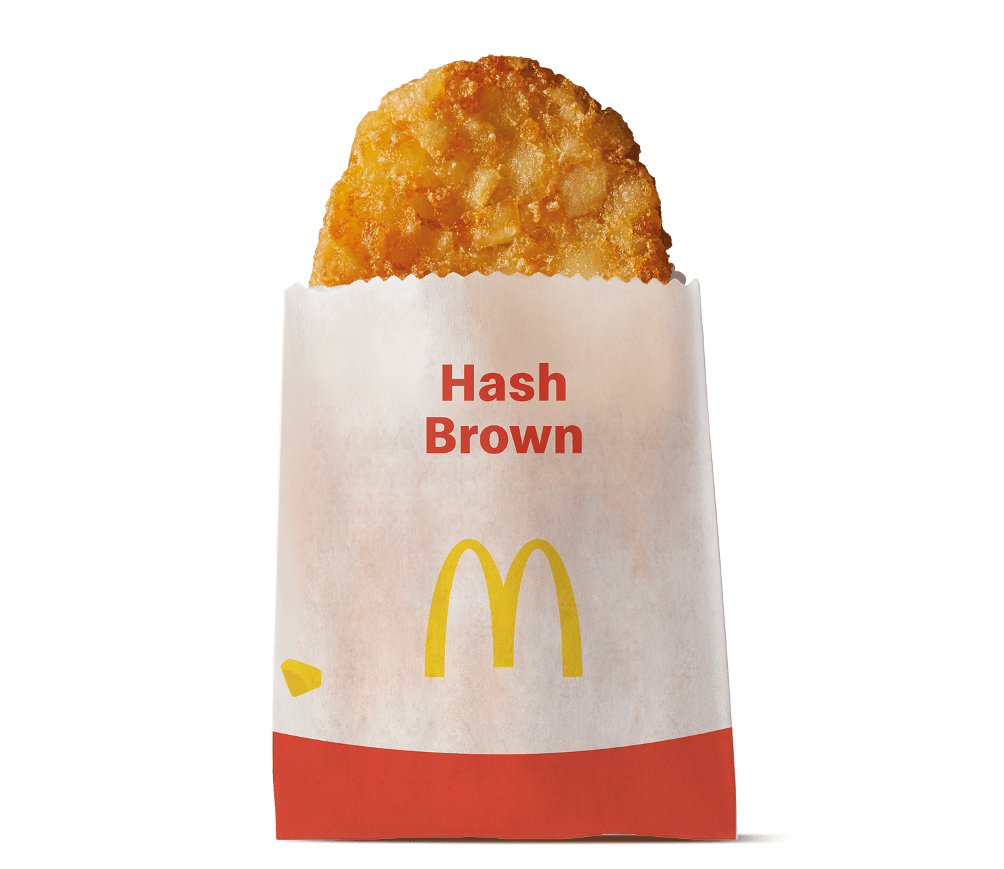
Check In
Halfway there!

Slide 3
Quick Recap!
Hashing, Collisions

Slide 4
Hashing – Key Idea
Table (array)
index
value
hash func
0x11222F
-
“value”
0x112233
0x112230
-
0x112231
-
0x112232
-
0x112233
-

Slide 5
Hashing – Key Idea
Table (array)
index
value
hash func
0x11222F
-
“value”
0x112233
0x112230
-
0x112231
-
0x112232
-
0x112233
“value”

Slide 6
Hashing – Key Idea
What?
Stores data in an array like structure, that enables lookup without linear traversal.
Why?
To support O(1) random access
How?
“Hash”-es the key into an integer-like.
Treats this as the index!

Slide 7
Hashing – Collisions
Table (array)
index
value
hash func
0x11222F
-
“value”
0x112233
0x112230
-
0x112231
-
0x112232
-
0x112233
“value”
0x112234
-

Slide 8
Hashing – Collisions
Table (array)
index
value
hash func
0x11222F
-
“super”
0x112233
0x112230
-
0x112231
-
0x112232
-
“value” is already there!
0x112233
“value”
0x112234
-

Slide 9
Hashing – Chaining
Why not store both?
Table (array)
index
value
0x112231
-
0x112232
-
0x112233
“value”
+
“super”
0x112234
-

Slide 10
Hashing – Chaining
Chaining
Hash table now points to linked list of values
Table (array)
index
value
0x112231
-
0x112232
-
0x112233
“value”
“super”
0x112234
-

Slide 11
Hashing – Chaining
However, this comes with additional storage!
Table (array)
index
value
0x112231
-
0x112232
-
0x112233
“value”
“super”
0x112234
-

Slide 12
Hashing – Collisions
Table (array)
What if,
index
value
hash func
0x11222F
-
“super”
0x112233
0x112230
-
0x112231
-
0x112232
-
0x112233
“value”
0x112234
-

Slide 13
Hashing – Open Addressing
Table (array)
we go to the next slot?
What if,
index
value
hash func
0x11222F
-
0x112233
0x112230
-
0x112231
-
0x112232
-
0x112233
“value”
0x112234
“super”

Slide 14
Hashing – Open Addressing
Table (array)
Open Addressing
Finds an open slot in the table
(probes the table for empty slot)
Linear Probing:
Searches sequentially
Quadratic Probing:
Searches by adding a quadratic factor each time
index
value
0x11222F
-
0x112230
-
0x112231
-
0x112232
-
0x112233
“value”
0x112234
“super”

Slide 15
Hashing - Runtime
For most collision cases, the worst case runtime is O(n)
However, the EXPECTED runtime is different!

Slide 16
Hashing performs well IF you have a good hash function!

Slide 17
Hashing - Runtime
For most collision cases, the worst case runtime is O(n)
However, the EXPECTED runtime is different!
Simple Uniform Hashing Assumption (SUHA)
Every key is equally likely to map to every bucket.
Probability = 1/m (m: # of buckets)

Slide 18
Hashing - Runtime
For most collision cases, the worst case runtime is O(n)
Expected Runtime: O(1) + n/m = O(1)
Simple Uniform Hashing Assumption (SUHA)
Every key is equally likely to map to every bucket.
Probability = 1/m (m: # of buckets)

Slide 19
Tutorial Problems
Hashing, Collision Management

Slide 20
1. Hashing Basics
Try hashing these items [42, 24, 18, 36, 52, 0, 47, 45, 60, 27, 32, 7] with the following hash function h(x) = x mod 7. Each row in the table corresponds to the bucket of h(x).

Slide 21

1. Hashing Basics
 | x₁ | x₂ | x₃ | x₄
0
1
2
3
4
5
6
42
24
18
36
52
0
$$h:x↦x mod 7$$
0
3
4
1
3
0

Slide 22
1. Hashing Basics
[42, 24, 18, 36, 52, 0, 47, 45, 60, 27, 32, 7]
 | x₁ | x₂ | x₃ | x₄
0
1
2
3
4
5
6
0
0
42
0
1
36
3
3
24
52
4
18

Slide 23
1. Hashing Basics
 | x₁ | x₂ | x₃ | x₄
0
1
2
3
4
5
6
0
0
42
0
1
36
47
45
60
27
32
7
$$h:x↦x mod 7$$
3
3
24
52
5
3
4
6
4
0
4
18

Slide 24
1. Hashing Basics
 | x₁ | x₂ | x₃ | x₄
0
1
2
3
4
5
6
0
0
42
0
7
0
1
36
3
3
3
24
52
45
4
18
60
32
4
4
5
47
6
27

Slide 25
1. Hashing Basics
What if instead of a Linked List, we use an AVL Tree to store the items in a bucket? What are the advantages or disadvantages of such a solution?

Slide 26
1. Hashing Basics
Worst Case Time Complexity for Search
2
1
3
1
2
3
4
Linked List: O(n)
4
AVL: O(log n)

Slide 27
1. Hashing Basics
Space?
2
1
3
1
2
3
4
4

Slide 28
1. Hashing Basics
Space? About the same (O(n))
2
1
3
1
2
3
4
4

Slide 29
1. Hashing Basics
About the same (O(n))
AVL Tree Node
However AVL tends to incur more overhead
2
value:
Linked List
left:
Reference
right:
1
Reference
value:
balance:
next:
Reference
int

Slide 30

1. Hashing Basics
For sure AVL is MUCH more complex to implement
Linked List
AVL Tree Node
you
you

Slide 31
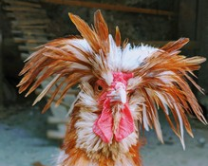
1. Hashing Basics
AVL Tree Node
you
me, grading ur code

Slide 32
1. Hashing Basics
However, if the hash function chosen is good enough (under uniform hashing assumption), the
expected time would be identical in both cases.
Trivia!
Java’s implementation of HashMap converts the buckets from a Linked List to Red Black Trees after a threshold number of buckets and bucket size

Slide 33
1. Hashing Basics
The goal of Hash Tables are to store (key, value) pairs. Here’s a question, at each bucket, is storing just the (value) sufficient? Or do we need to store the entire (key, value) pair? Why do you think so?

Slide 34

1. Hashing Basics
Using the hash function from the first part
(8, “A”)
(15, “A”)
$$h:(x,y)↦x mod 7$$
1
1

Slide 35
1. Hashing Basics
Using the hash function from the first part
(8, “A”)
(15, “A”)
1
1
1
A
$$h:(x,y)↦x mod 7$$

Slide 36
1. Hashing Basics
1
A
Does this also mean that (22, “A”) is in the hash table?
But we don’t have entry for (22, “A”) …

Slide 37
1. Hashing Basics
Using the hash function from the first part
(8, “A”)
(15, “B”)
$$h:(x,y)↦x mod 7$$
1
1

Slide 38
1. Hashing Basics
Using the hash function from the first part
(8, “A”)
(15, “B”)
1
1
1
A
B
$$h:(x,y)↦x mod 7$$

Slide 39
1. Hashing Basics
1
1
1
A
B
Which value corresponds to the key of 15?

Slide 40
1. Hashing Basics
1
1
1
A
B
$∴$ It is necessary to store both the KEY and the VALUE!

Slide 41
2. Coupon Chaos
Mr. Nodle has some coupons that he wishes to spend at his favourite cafe on campus, but there are different types of coupons. In particular, there are t distinct coupon types, and he can have any number of each type (including 0). He has n coupons in total.
He wishes to use one coupon a day, starting from day 1. He wishes to use his coupons in ascending order and will use up all his coupons that are of a lower type first before moving on to the next type. Nodle wishes to build a calendar that will state which coupon he will be using.

Slide 42
2. Coupon Chaos
The list of coupons will be given in an array. An example of a possible input is: [5, 20, 5, 20, 3, 20, 3, 20]. Here, t = 3, and n = 8. The output here would be [3, 3, 5, 5, 20, 20, 20, 20].
Since the menu at the cafe that he frequents is not very diverse, there aren’t many different types of coupons. So we’ll say that t is much smaller than n.
Give as efficient an algorithm as you can, to build his calendar for him

Slide 43

2. Coupon Chaos
This is just a sorting problem with many duplicates!

Slide 44
2. Coupon Chaos
Method 1 .
AVL Tree where each node stores a count
5
cnt: 2
3
20
cnt: 2
cnt: 4
[5, 20, 5, 20, 3, 20, 3, 20]

Slide 45
2. Coupon Chaos
Method 1 .
AVL Tree where each node stores a count
5
cnt: 2
3
20
[5, 20, 5, 20, 3, 20, 3, 20]
cnt: 2
cnt: 4
Perform In-Order Traversal

Slide 46
2. Coupon Chaos
Method 1 .
AVL Tree where each node stores a count
5
cnt: 2
3
20
[5, 20, 5, 20, 3, 20, 3, 20]
cnt: 2
cnt: 4
Perform In-Order Traversal
3
3

Slide 47
2. Coupon Chaos
Method 1 .
AVL Tree where each node stores a count
5
cnt: 2
3
20
[5, 20, 5, 20, 3, 20, 3, 20]
cnt: 2
cnt: 4
Perform In-Order Traversal
3
3
5
5

Slide 48
2. Coupon Chaos
Method 1 .
AVL Tree where each node stores a count
5
cnt: 2
3
20
[5, 20, 5, 20, 3, 20, 3, 20]
cnt: 2
cnt: 4
Perform In-Order Traversal
3
3
5
5
20
20
20
20

Slide 49
2. Coupon Chaos
Method 2 .
QuickSort with 3 way partitioning
5
20
5
20
3
20
3
20

Slide 50
2. Coupon Chaos
Method 2 .
QuickSort with 3 way partitioning
5
20
5
20
3
20
3
20

Slide 51
2. Coupon Chaos
Method 2 .
QuickSort with 3 way partitioning
3
3
5
5
20
20
20
20

Slide 52
2. Coupon Chaos
Method 2 .
QuickSort with 3 way partitioning
3
3
5
5
20
20
20
20

Slide 53

2. Coupon Chaos
Method 3 .

Slide 54
2. Coupon Chaos
Method 3 .
Hash Table to store the count of each key, List to store all keys we found
5
20
5
20
3
20
3
20

Slide 55
5
20
5
20
3
20
3
20
Key
Val
Create empty hash table and list
List

Slide 56
20
5
20
3
20
3
20
Key
5
Val
1
Check hash table, add count
List

Slide 57
20
5
20
3
20
3
20
Key
5
Val
1
Add to list of keys
List
5

Slide 58
5
20
3
20
3
20
Key
5
20
Val
1
1
Check hash table, add count
List
5

Slide 59
5
20
3
20
3
20
Key
5
20
Val
1
1
Add to list of keys
List
5
20

Slide 60
20
3
20
3
20
5
20
Key
5
Val
2
1
Check hash table, add count
List
5
20

Slide 61
3
20
3
20
5
20
Key
5
20
Val
2
2
Repeat
List
5
20

Slide 62
20
3
20
5
20
Key
5
20
3
Val
2
2
1
Repeat
List
5
20
3

Slide 63
3
20
5
20
5
20
Key
20
3
Val
2
3
1
Repeat
List
5
20
3

Slide 64
20
5
20
3
5
20
Key
20
3
Val
2
3
2
Repeat
List
5
20
3

Slide 65
5
20
3
5
20
20
Key
20
3
Val
2
4
2
Repeat
List
5
20
3

Slide 66
5
20
3
5
20
20
Key
20
3
Val
2
4
2
Sort the list of keys
List
5
20
3

Slide 67
5
20
3
5
20
20
Key
20
3
Val
2
4
2
Sort the list of keys
List
3
5
20

Slide 68
5
20
3
5
20
20
Key
20
3
Val
2
4
2
Retrieve count from hash table
List
3
5
20

Slide 69
3
3
5
20
5
20
20
Key
20
Val
2
4
Retrieve count from hash table
List
3
5
20

Slide 70
3
3
5
20
5
20
20
Key
20
Val
2
4
Retrieve count from hash table
List
3
5
20

Slide 71
3
3
5
5
20
20
20
Key
20
Val
4
Retrieve count from hash table
List
3
5
20

Slide 72
3
3
5
5
20
20
20
Key
20
Val
4
Retrieve count from hash table
List
3
5
20

Slide 73
3
3
5
5
20
20
20
20
Key
Val
Retrieve count from hash table
List
3
5
20

Slide 74
Sorted!
3
3
5
5
20
20
20
20

Slide 75

2. Coupon Chaos
Runtime Analysis
log t levels, n insertions
AVL Tree
Time = time to insert + time to traverse
= O(n log t + t) $≈$ O(n log t)
n elements, t distinct keys
QuickSort
Time = O(n) partition * log t levels
= O(n log t)

Slide 76
2. Coupon Chaos
Runtime Analysis
t keys, n insertions
Hash + Array
Time = time to insert + time to sort
= O(n) + O(t log t)
= O(n + t log t)
If t << n, then O(n + t log t) $≈$ O(n)!

Slide 77
3. The Missing Element
Given n items in no particular order, but this time possibly with duplicates, find the first missing number (if we were to start counting from 1), or output “all present” if all values 1 to n were present in the input.

Slide 78
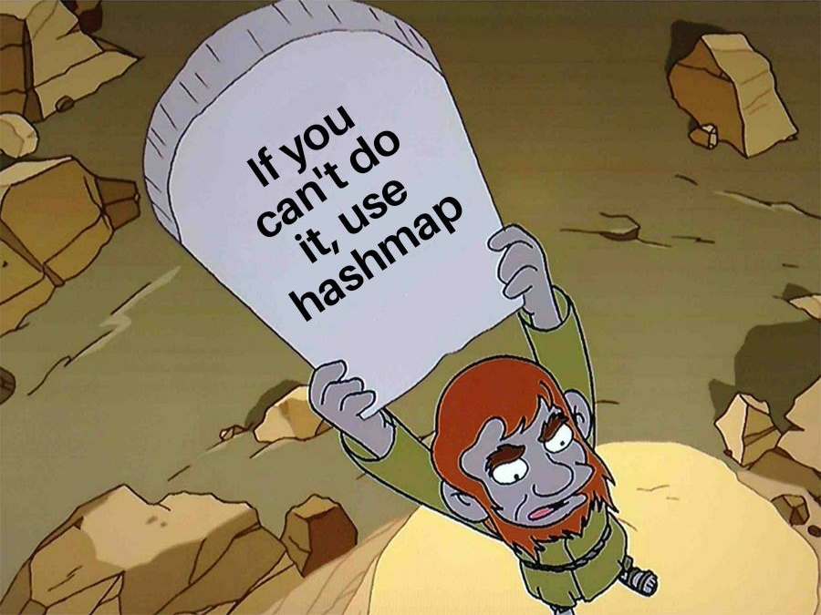

Slide 79
3. The Missing Element
Use a HashSet to store all the values that we’ve seen in the array
Ignore Duplicates
>> Go through the hash set to check if each number was present, starting from 1

Slide 80
3. The Missing Element
Use a HashSet to store all the values that we’ve seen in the array
Ignore Duplicates
>> Go through the hash set to check if each number was present, starting from 1
Runtime: O(n).
Space: O(n).

Slide 81
3. The Missing Element
Follow Up!
Can we do the same thing using O(1) space? i.e. in-place

Slide 82
3. The Missing Element
Follow Up!
Can we do the same thing using O(1) space? i.e. in-place
8
5
3
3
2
1
5
4
2
1
2
3
4
5
6
7
8
9
(assume array is 1-indexed)

Slide 83
3. The Missing Element
Follow Up!
Can we do the same thing using O(1) space? i.e. in-place
8
5
3
3
2
1
5
4
2
1
2
3
4
5
6
7
8
9
Take 8

Slide 84
3. The Missing Element
Follow Up!
Can we do the same thing using O(1) space? i.e. in-place
4
5
3
3
2
1
5
8
2
1
2
3
4
5
6
7
8
9
Kick number 4 in position 8. Swap in place

Slide 85
3. The Missing Element
Follow Up!
Can we do the same thing using O(1) space? i.e. in-place
4
5
3
3
2
1
5
8
2
1
2
3
4
5
6
7
8
9
Continue with 4

Slide 86
3. The Missing Element
Follow Up!
Can we do the same thing using O(1) space? i.e. in-place
3
5
3
4
2
1
5
8
2
1
2
3
4
5
6
7
8
9
Swap with position 4

Slide 87
3. The Missing Element
Follow Up!
Can we do the same thing using O(1) space? i.e. in-place
3
5
3
4
2
1
5
8
2
1
2
3
4
5
6
7
8
9
Continue with 3

Slide 88
3. The Missing Element
Follow Up!
Can we do the same thing using O(1) space? i.e. in-place
3
5
3
4
2
1
5
8
2
1
2
3
4
5
6
7
8
9
Oops, seems like another 3 has occupied the place!

Slide 89
3. The Missing Element
Follow Up!
Can we do the same thing using O(1) space? i.e. in-place
3
5
3
4
2
1
5
8
2
1
2
3
4
5
6
7
8
9
Leave alone :)

Slide 90
3. The Missing Element
Follow Up!
Can we do the same thing using O(1) space? i.e. in-place
3
5
3
4
2
1
5
8
2
1
2
3
4
5
6
7
8
9
Repeat

Slide 91
3. The Missing Element
Follow Up!
Can we do the same thing using O(1) space? i.e. in-place
3
2
3
4
5
1
5
8
2
1
2
3
4
5
6
7
8
9
Repeat

Slide 92
3. The Missing Element
Follow Up!
Can we do the same thing using O(1) space? i.e. in-place
3
2
3
4
5
1
5
8
2
1
2
3
4
5
6
7
8
9
Repeat

Slide 93
3. The Missing Element
Follow Up!
Can we do the same thing using O(1) space? i.e. in-place
1
2
3
4
5
3
5
8
2
1
2
3
4
5
6
7
8
9
Repeat

Slide 94
3. The Missing Element
Follow Up!
Can we do the same thing using O(1) space? i.e. in-place
1
2
3
4
5
3
5
8
2
1
2
3
4
5
6
7
8
9
Repeat

Slide 95
3. The Missing Element
Follow Up!
Can we do the same thing using O(1) space? i.e. in-place
1
2
3
4
5
3
5
8
2
1
2
3
4
5
6
7
8
9
Repeat

Slide 96
3. The Missing Element
Follow Up!
Can we do the same thing using O(1) space? i.e. in-place
1
2
3
4
5
3
5
8
2
1
2
3
4
5
6
7
8
9
Run through the array one more time, check if at index i, the value of i is stored

Slide 97
3. The Missing Element
Follow Up!
Can we do the same thing using O(1) space? i.e. in-place
6
Return the index

Slide 98
3. The Missing Element
Follow Up!
Can we do the same thing using O(1) space? i.e. in-place
6
Cuckoo Hashing
en.wikipedia.org/wiki/Cuckoo_hashing

Slide 99
4. Data Structure 2.0
Implement a data structure RandomizedSet with the following operations:
1. RandomizedSet() which initializes the data structure.
2. Insert(val) which inserts an item val into the set if not present.
3. Remove(val) which removes the item val from the set if present.
4. GetRandom() which returns a random element from the current set of elements. Every element must have an equal probability of being returned.
All these operations must work in expected O(1) time!
1
2
3
4
5

Slide 100
4. Data Structure 2.0
Implement a data structure RandomizedSet with the following operations:
1. RandomizedSet() which initializes the data structure.
2. Insert(val) which inserts an item val into the set if not present.
3. Remove(val) which removes the item val from the set if present.
4. GetRandom() which returns a random element from the current set of elements. Every element must have an equal probability of being returned.
All these operations must work in expected O(1) time !
1
2
3
4
5

Slide 101
4. Data Structure 2.0
1
4
3
2
Combination of an Array and a Hash Table
Table
1
2
3
4
5
Array
size:
0

Slide 102
4. Data Structure 2.0
Upon initialization of RandomisedSet, initialize array with size n, and an empty HashTable
Array
Table
1
4
3
2
size:
0

Slide 103
4. Data Structure 2.0
insert(val):
Append value to array
Array
15
Table
4
3
2
size:
0

Slide 104
4. Data Structure 2.0
insert(val):
Increment size of array by 1
Array
15
Table
4
3
2
size:
1

Slide 105
4. Data Structure 2.0
insert(val):
Add (val, size) to Hashtable (e.g. hash function = mod 2)
Array
15
Table
3
2
1
(15, 1)
size:
1

Slide 106
4. Data Structure 2.0
insert(val):
Append value to array
Array
15
20
Table
2
1
(15, 1)
size:
1

Slide 107
4. Data Structure 2.0
insert(val):
Increment size by 1
Array
15
20
Table
2
1
(15, 1)
size:
2

Slide 108
4. Data Structure 2.0
insert(val):
Add (val, size) to hashtable (assume h: x → x mod 2)
Array
15
20
Table
0
(20, 2)
2
1
(15, 1)
size:
2

Slide 109
4. Data Structure 2.0
GetRandom()
Generate random integer from 1 to size
size:
2
2
Call randint perhaps

Slide 110
4. Data Structure 2.0
GetRandom(val):
Retrieve the array’s value at that random index
Array
15
20
Table
0
(20, 2)
2
1
(15, 1)
size:
2

Slide 111
4. Data Structure 2.0
remove(val)
Check if it is in the table (e.g. remove(15))
Array
15
20
Table
0
(20, 2)
2
1
(15, 1)
size:
2

Slide 112
4. Data Structure 2.0
remove(val)
Check if it is in the table (e.g. remove(15))
Array
15
20
Table
0
(20, 2)
2
1
(15, 1)
size:
2

Slide 113
4. Data Structure 2.0
remove(val)
Get the location of the value in the array
Array
15
20
Table
0
(20, 2)
2
1
(15, 1)
size:
2

Slide 114
4. Data Structure 2.0
remove(val)
Swap with the back of the array, update table
Array
20
15
Table
0
(20, 1)
2
1
(15, 2)
size:
2

Slide 115
4. Data Structure 2.0
remove(val)
Decrement size
Array
20
15
Table
0
(20, 1)
2
1
(15, 2)
size:
1

Slide 116
4. Data Structure 2.0
remove(val)
Remove val, size pair from table
Array
20
15
Table
0
(20, 1)
2
size:
1

Slide 117
4. Data Structure 2.0
RandomisedSet()
Initialise array with size n + empty hashtable
Insert value to array, increment size, add (val, size) to hashtable
insert(val)
2
remove(val)
Check hashtable if val is in the array. If it is, retrieve the location and swap the element to the last. Remove the element, decrement size, remove pair from table
getRandom()
Random int from 0 to size.
Get array value there.

Slide 118
5. Data Structure 3.0
Implement a data structure with the following operations:
1. Insert in O(log n) time
2. Delete in O(log n) time
3. Lookup in O(1) time
4. Find successor and predecessor in O(1) time
1
2
3
4
5

Slide 119
5. Data Structure 3.0
Implement a data structure with the following operations:
1. Insert in O(log n) time
2. Delete in O(log n) time
3. Lookup in O(1) time
4. Find successor and predecessor in O(1) time
1
2
3
4
5
Can we use purely a hash table?

Slide 120
5. Data Structure 3.0
Implement a data structure with the following operations:
1. Insert in O(log n) time
2. Delete in O(log n) time
3. Lookup in O(1) time
4. Find successor and predecessor in O(1) time
1
2
3
4
5
Can we use purely a hash table?
O(n) time to find successor/predecessor

Slide 121
5. Data Structure 3.0
Can we use purely a hash table?
O(n) time to find successor/predecessor
Especially for S P A R S E data
Key
1
2
3
…
100
101
102
…
997
998
999
Val
1
2
3
…
100
1
102
…
997
998
1

Slide 122
5. Data Structure 3.0
Implement a data structure with the following operations:
1. Insert in O(log n) time
2. Delete in O(log n) time
3. Lookup in O(1) time
4. Find successor and predecessor in O(1) time
1
2
3
4
5
Can we use purely AVL tree?

Slide 123
5. Data Structure 3.0
Implement a data structure with the following operations:
1. Insert in O(log n) time
2. Delete in O(log n) time
3. Lookup in O(1) time
4. Find successor and predecessor in O(1) time
1
2
3
4
5
Can we use purely AVL tree?
Clearly Not!

Slide 124
5. Data Structure 3.0
AVL Tree
HashTable
Insert O(log n)
Delete O(log n)
Lookup O(log n)
Predec. O(log n)
Insert O(1)
Delete O(1)
Lookup O(1)
Predec. O(n)
1
2
3
4
5

Slide 125
5. Data Structure 3.0
AVL Tree
HashTable
Insert O(log n)
Delete O(log n)
Lookup O(log n)
Predec. O(log n)
Insert O(1)
Delete O(1)
Lookup O(1)
Predec. O(n)
1
2
3
4
5
Get the best of both worlds!

Slide 126
5. Data Structure 3.0
Modifications!
AVL Tree
Modify node to store pointer to the predecessor and successor
1
2
3
4
5
HashTable
Store the pointer to the AVL tree node

Slide 127

Conclusion

Slide 128
Midterm Review

Slide 129
See you next week!

